Slide 1
IMPLEMENTATION DIAGRAM

Slide 2
What is meant by implementation diagram?
The UML defines several diagrams that can be used to illustrate implementation details.
The most commonly used is a deployment diagram, to illustrate the deployment of components and processes to processing nodes.

Slide 3
What are the two types of implementation diagram?
The two types of implementation diagrams are component diagrams and deployment diagrams.
Component diagrams are modeled to illustrate relationship between piece of software, while deployment diagram are modeled to illustrate relationships between piece of hardware.

Slide 4
Types of Implementation Diagrams
There are two types of implementation diagrams:
component diagrams show the structure of the code itself
deployment diagrams show the structure of the runtime system

Slide 5
Component Vs Deployment
Component diagrams are used to describe the components and deployment diagrams shows how they are deployed in hardware.

Slide 6
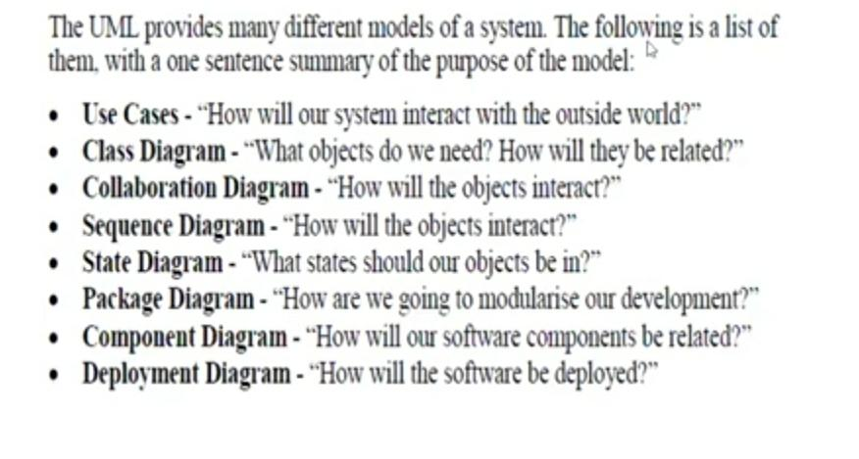

Slide 7
Deployment diagram
In Unified Modeling Language (UML), a deployment diagram falls under the structural diagramming family because it describes an aspect of the system itself.
A deployment diagram allows you to represent the execution environment for a project.
It describes the hardware on which each of your components will run and how that hardware is connected together.
Deployment diagram represents or describe the static deployment view of a system.
It specifies the physical hardware on which the software system will execute.
It also determines how the software is deployed on the underlying hardware.
It maps software pieces of a system to the device that are going to execute it. In this case, the deployment diagram describes the physical deployment of information generated by the software program on hardware components.
The information that the software generates is called an artifact.

Slide 8
Deployment Diagram - What it shows ?
It show the configuration of run-time processing elements and the software components, processes, and objects that live in them.
Software component instances represent run-time manifestations of code units.

Slide 9
Purpose of a deployment diagram
Deployment diagrams are used with the sole purpose of describing how software is deployed into the hardware system.
It visualizes how software interacts with the hardware to execute the complete functionality.
It is used to describe software to hardware interaction and vice versa.

Slide 10
Deployment diagrams can be used −
To model the hardware topology of a system.
To model the embedded system.
To model the hardware details for a client/server system.
To model the hardware details of a distributed application.

Slide 11
A deployment diagram consists of the following notations:
A node
A component
An artifact
An interface

Slide 12
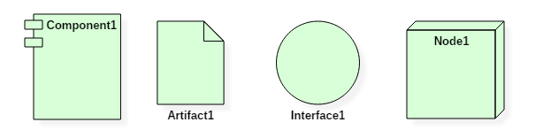
Deployment Diagram Symbol and notations

Slide 13
The software systems are manifested using various artifacts, and then they are mapped to the execution environment that is going to execute the software such as nodes.
Many nodes are involved in the deployment diagram; hence, the relation between them is represented using communication paths.

Slide 14
NODES
There are two types of nodes in a deployment diagram:
Device nodes
execution environment nodes
Device nodes are computing resources with processing capabilities and the ability to execute programs.
* Some examples of device nodes include PCs, laptops, and mobile phones.
An execution environment node, or EEN, is any computer system that resides within a device node.
* It could be an operating system, a JVM, or another servlet container.

Slide 15
The three-dimensional boxes, known as nodes, represent the basic software or hardware elements, or nodes, in the system.
Lines from node to node indicate relationships, and the smaller shapes contained within the boxes represent the software artifacts that are deployed.

Slide 16
Database
Databases represent any data stored by the deployed system. In some instances, you'll see a database represented as just another node, but sometimes you will see this shape as a database.

Slide 17
Other shapes
Communication path: A straight line that represents communication between two device nodes.
Artifacts: A box with the header ">" and then the name of the file.
Component: An entity required to execute a stereotype function.
Dependency: A dependency is a relationship that signifies that a single or a set of model elements requires other model elements for their specification or implementation.This means that the complete semantics of the depending elements is either semantically or structurally dependent on the definition of the supplier element(s).

Slide 18
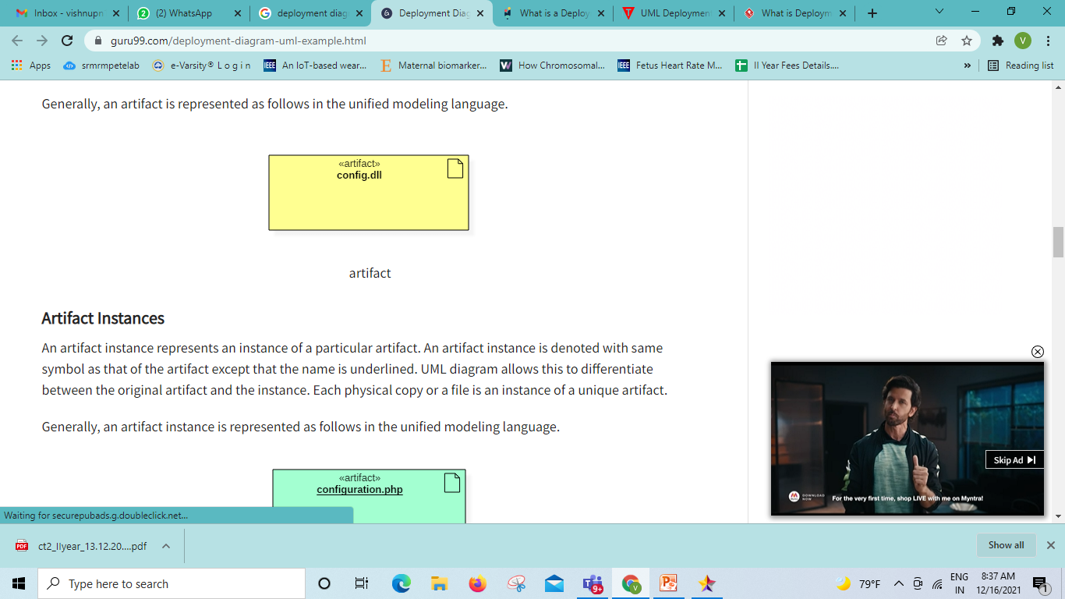
What is an artifact?
An artifact represents the specification of a concrete real-world entity related to software development.
You can use the artifact to describe a framework which is used during the software development process or an executable file. Artifacts are deployed on the nodes. The most common artifacts are as follows,
Source files
Executable files
Database tables
Scripts
DLL files
User manuals or documentation
Output files
Artifacts are deployed on the nodes. It can provide physical manifestation for any UML element. Generally, they manifest components. Artifacts are labeled with the stereotype <<artifact>>, and it may have an artifact icon on the top right corner.
Each artifact has a filename in its specification that indicates the physical location of the artifact. An artifact can contain another artifact. It may be dependent on one another.

Slide 19
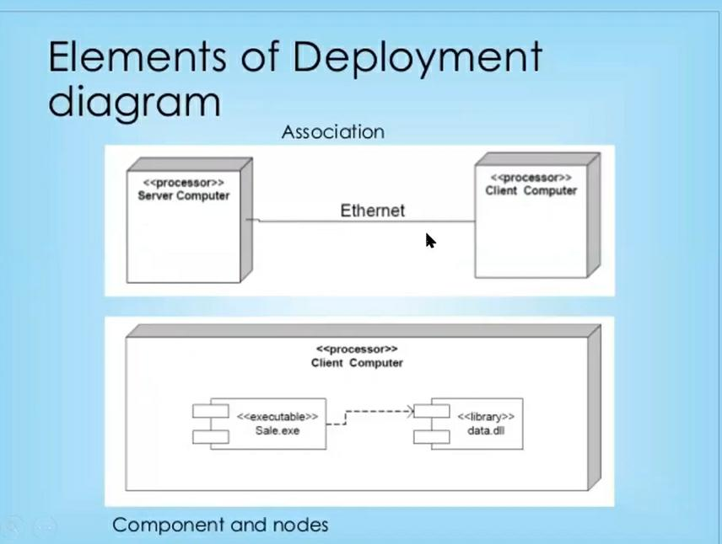

Slide 20
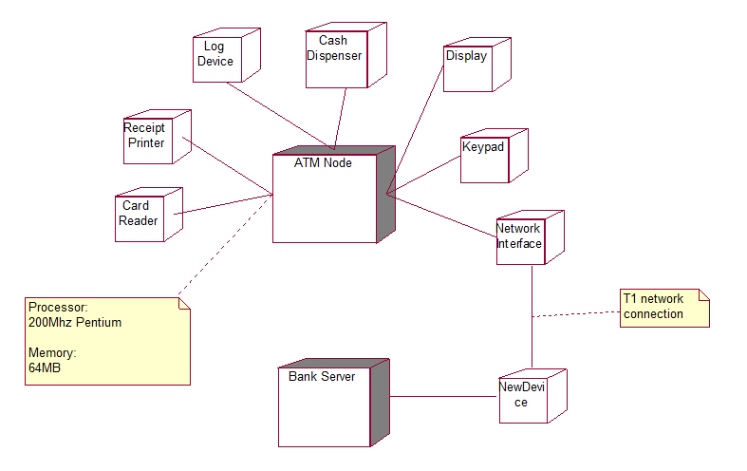
Deployment Diagram for ATM System

Slide 21
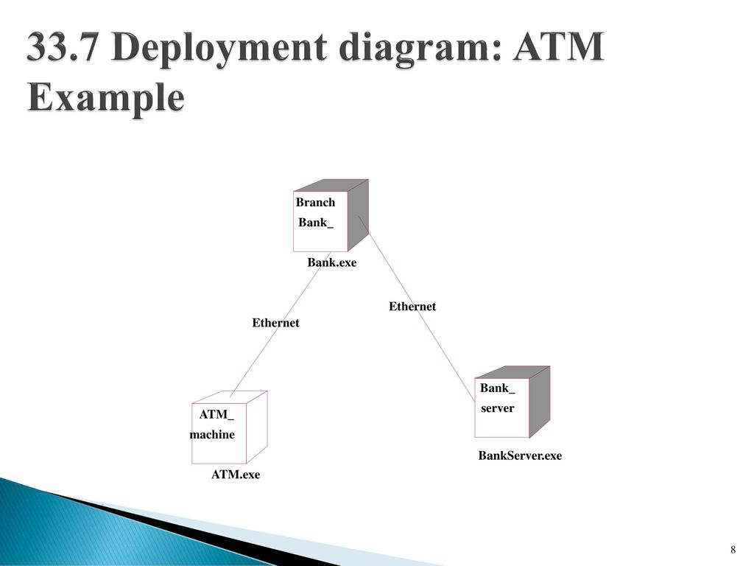

Slide 22
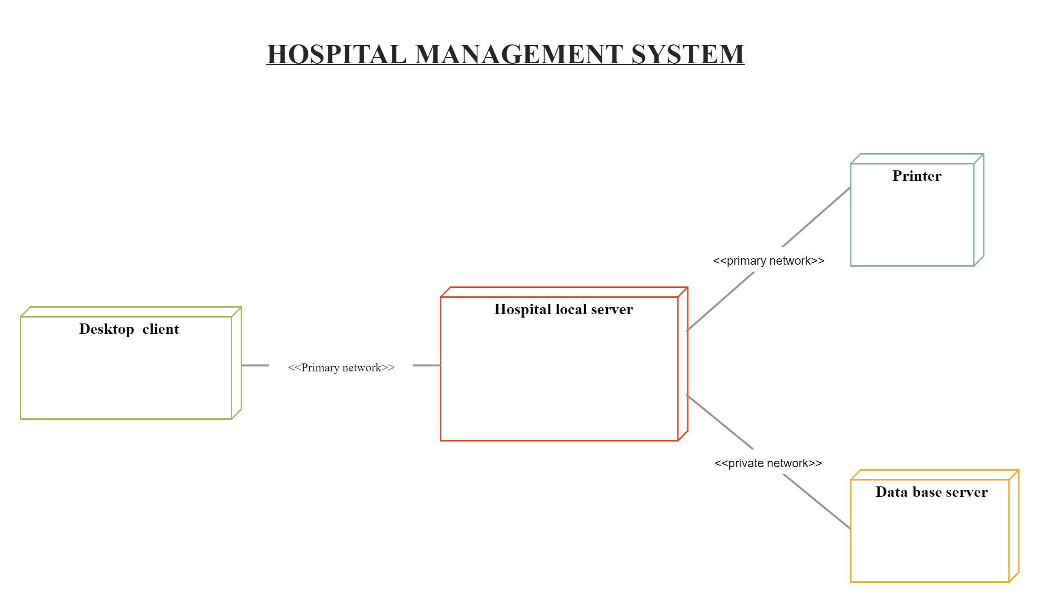

Slide 23
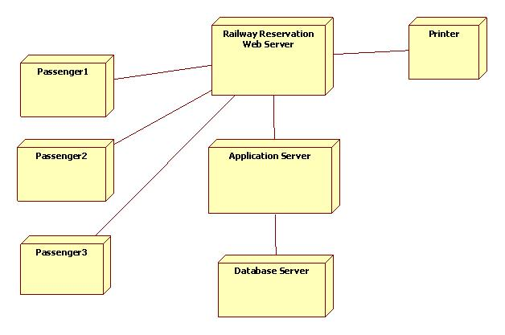
Deployment Diagram for Railway Reservation System

Slide 24
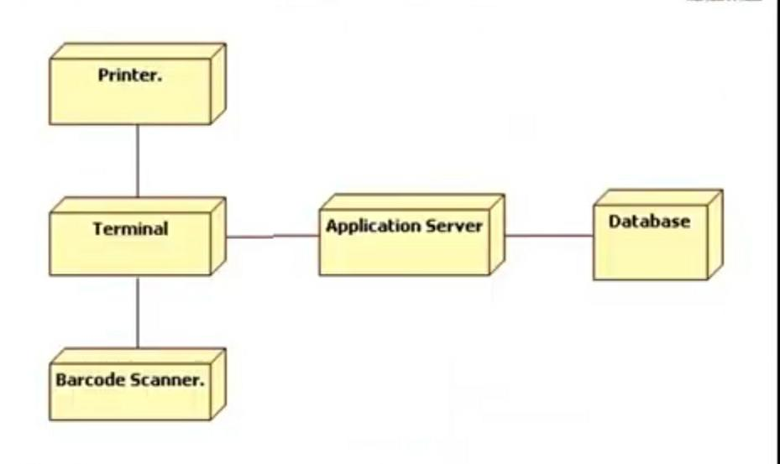
POS System

Slide 25
What is UML component diagram?
Component diagram is a special kind of diagram in UML.
Thus from that point of view, component diagrams are used to visualize the physical components in a system.
These components are libraries, packages, files, etc. Component diagrams can also be described as a static implementation view of a system.
Component diagrams commonly contain Components, Interfaces and Dependency, generalization, association, and realization relationships.

Slide 26
The purpose of the component diagram can be summarized as −
Visualize the components of a system.
Construct executables by using forward and reverse engineering.
Describe the organization and relationships of the components.

Slide 27
Component diagrams can be used to −
Model the components of a system.
Model the database schema.
Model the executables of an application.
Model the system's source code.

Slide 28
Before drawing a component diagram, the following artifacts are to be identified clearly −
Files used in the system.
Libraries and other artifacts relevant to the application.
Relationships among the artifacts.
After identifying the artifacts, the following points need to be kept in mind.
Use a meaningful name to identify the component for which the diagram is to be drawn.
Prepare a mental layout before producing the using tools.
Use notes for clarifying important points.

Slide 29
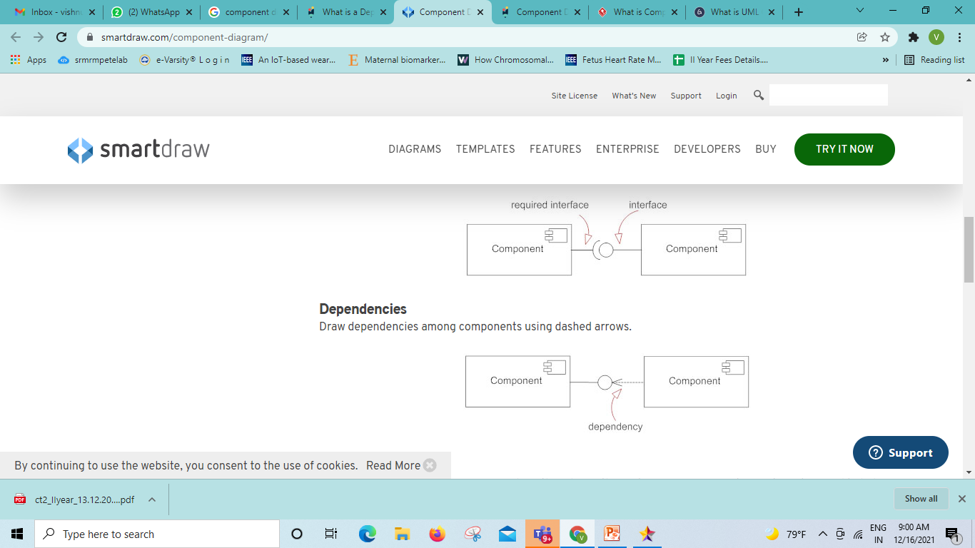
Notations of Component diagram
Component
A component is a logical unit block of the system, a slightly higher abstraction than classes. It is represented as a rectangle with a smaller rectangle in the upper right corner with tabs or the word written above the name of the component to help distinguish it from a class.
Interface
Interfaces in component diagrams show how components are wired together and interact with each other. The assembly connector allows linking the component’s required interface (represented with a semi-circle and a solid line) with the provided interface (represented with a circle and solid line) of another component. This shows that one component is providing the service that the other is requiring
In otherway it is a (small circle or semi-circle on a stick) describes a group of operations used (required) or created (provided) by components. A full circle represents an interface created or provided by the component. A semi-circle represents a required interface, like a person's input.

Slide 30
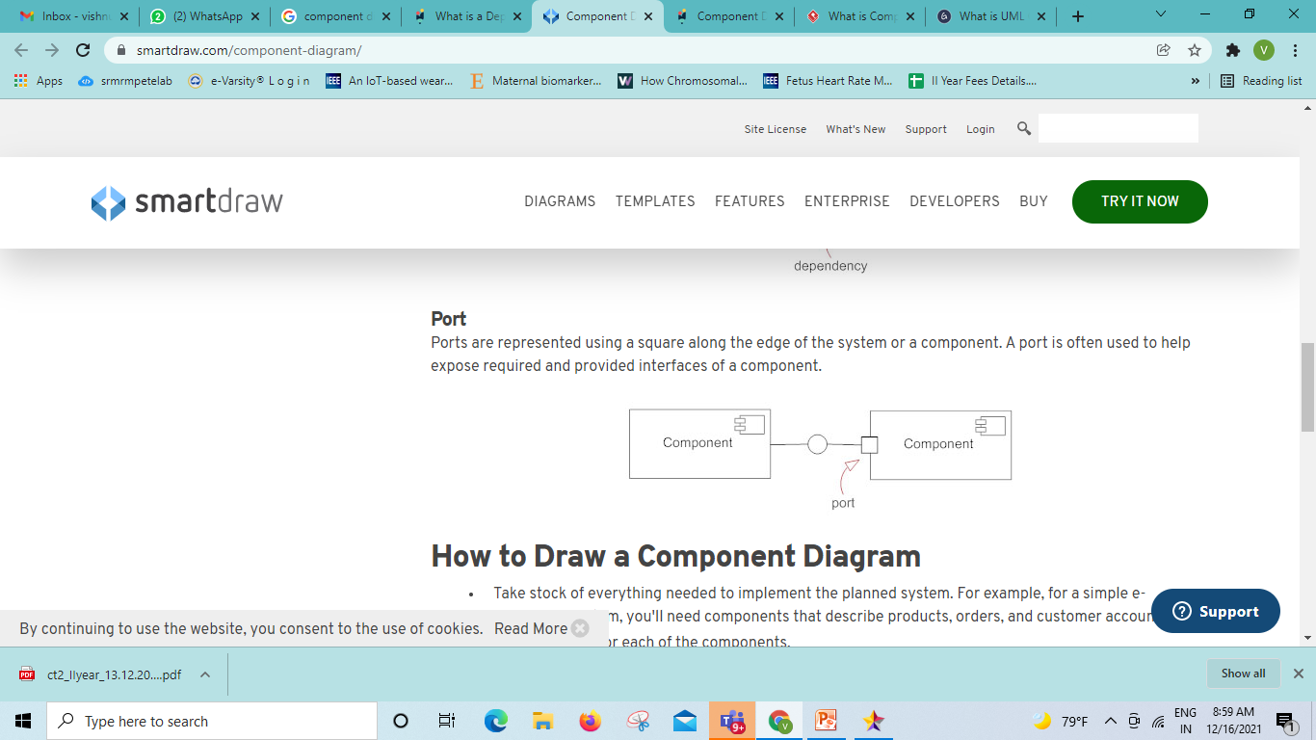
Dependencies
Draw dependencies among components using dashed arrows.
Port
Ports are represented using a square along the edge of the system or a component. A port is often used to help expose required and provided interfaces of a component.

Slide 31
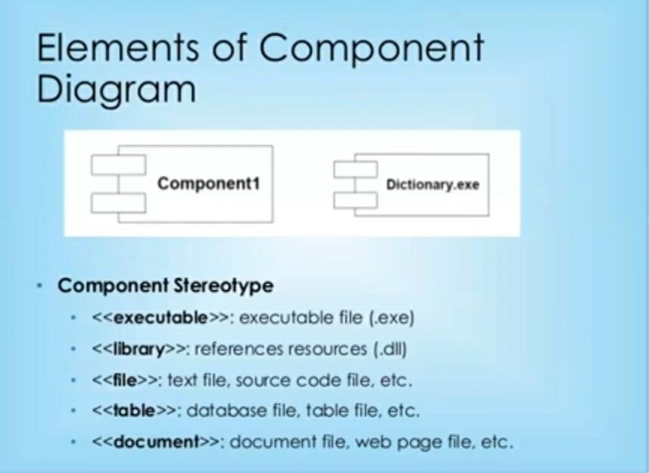

Slide 32
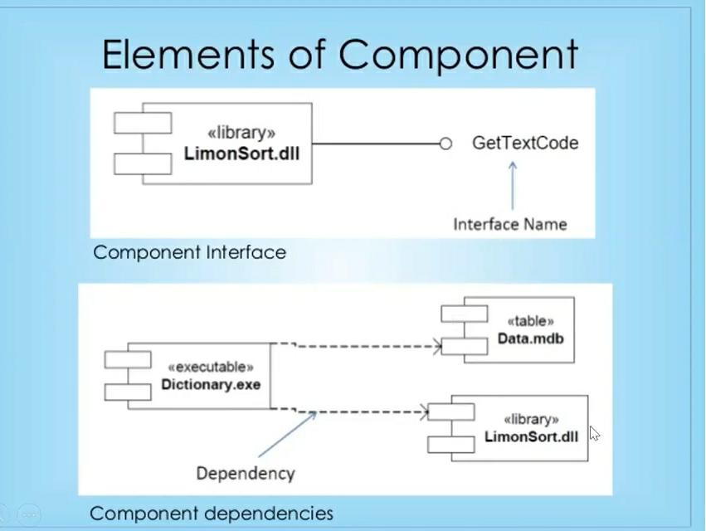

Slide 33
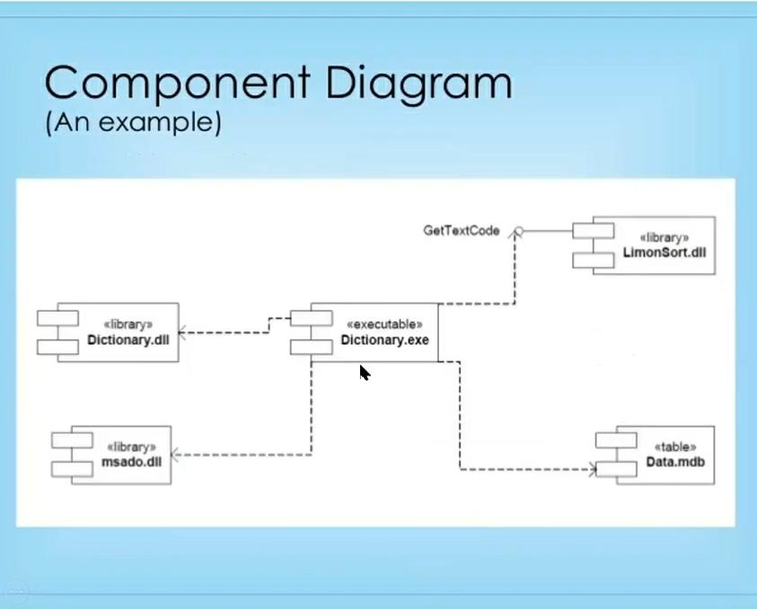

Slide 34
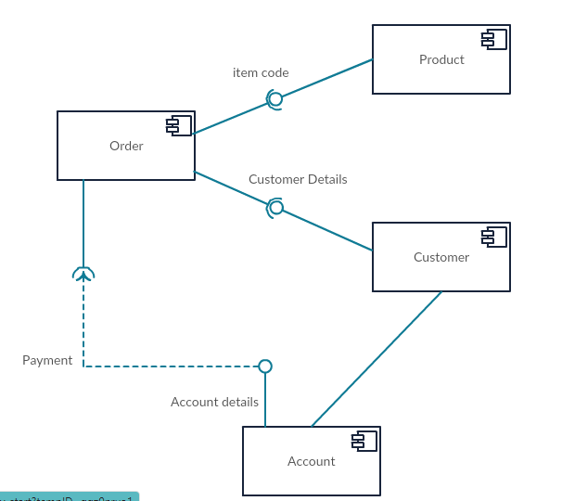
Component Diagram for Online Shopping System

Slide 35
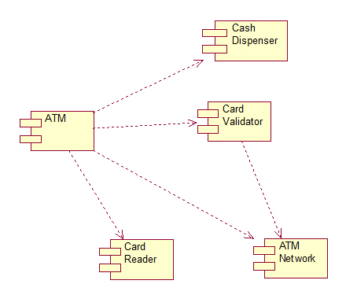
Component Diagram for ATM System

Slide 36
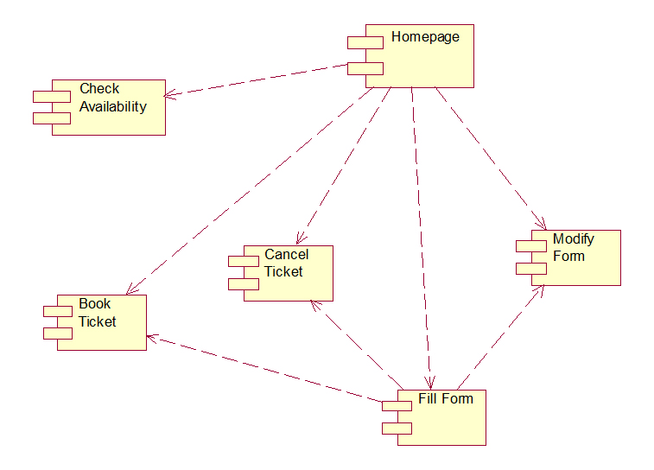
Component Diagram for Railway Reservation System

Slide 37
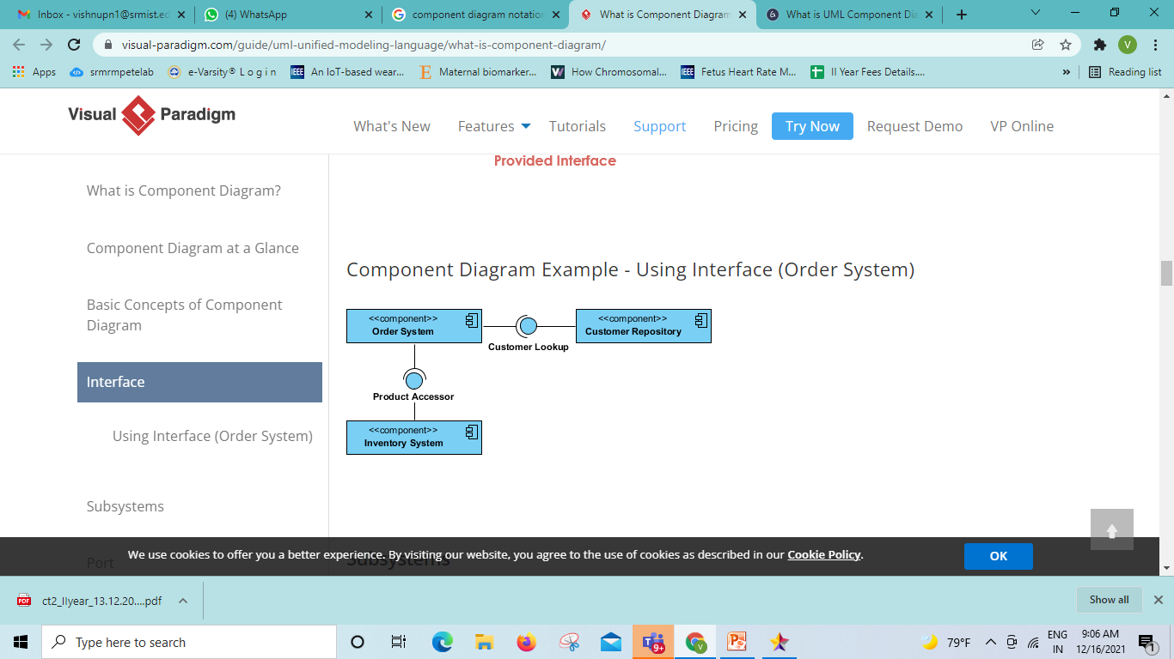

Slide 38
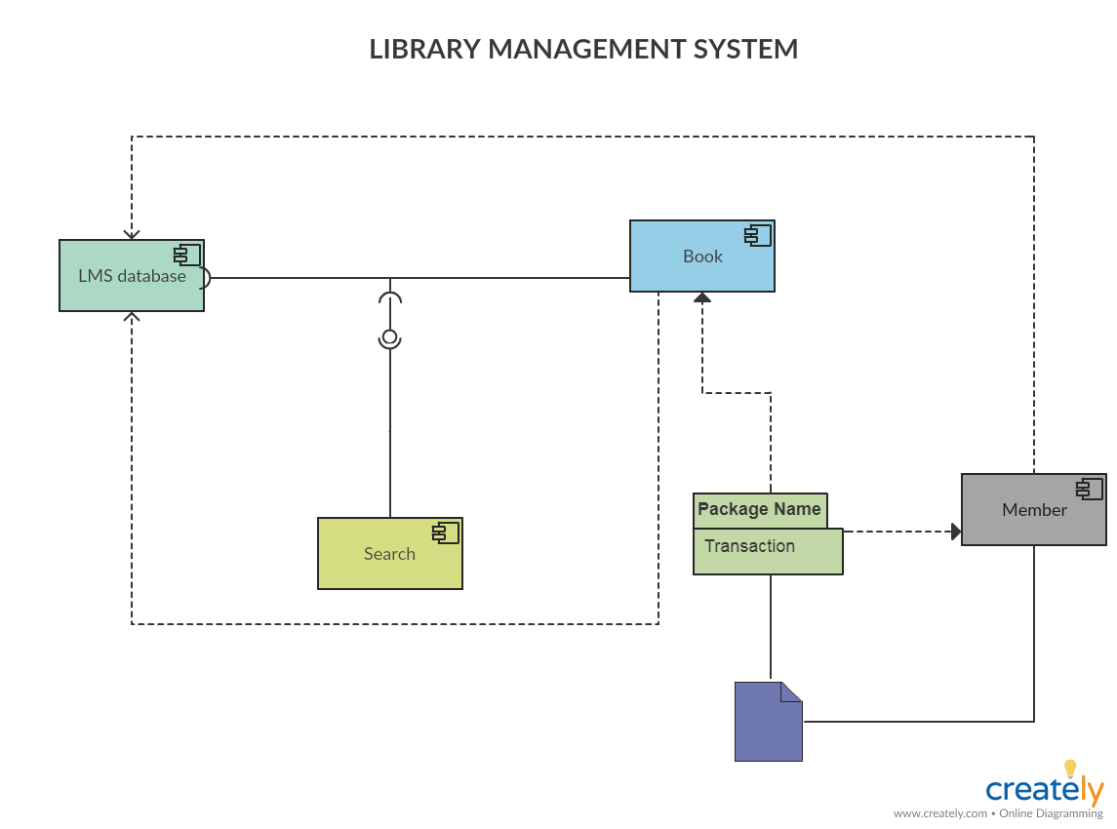

Slide 39
What is a package diagram?
Package diagrams are structural diagrams used to show the organization and arrangement of various model elements in the form of packages.
A package is a grouping of related UML elements, such as diagrams, documents, classes, or even other packages.
Each element is nested within the package, which is depicted as a file folder within the diagram, then arranged hierarchically within the diagram.
Package diagrams are most commonly used to provide a visual organization of the layered architecture within any UML classifier, such as a software system.

Slide 40
Benefits of a package diagram
A well-designed package diagram provides numerous benefits to those looking to create a visualization of their UML system or project.
They provide a clear view of the hierarchical structure of the various UML elements within a given system.
These diagrams can simplify complex class diagrams into well-ordered visuals.
They offer valuable high-level visibility into large-scale projects and systems.
Package diagrams can be used to visually clarify a wide variety of projects and systems.
These visuals can be easily updated assystems and projects evolve.

Slide 41
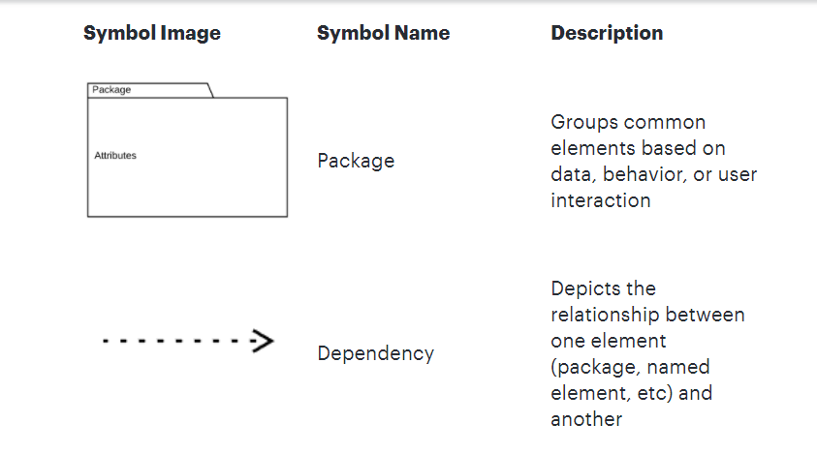

Slide 42
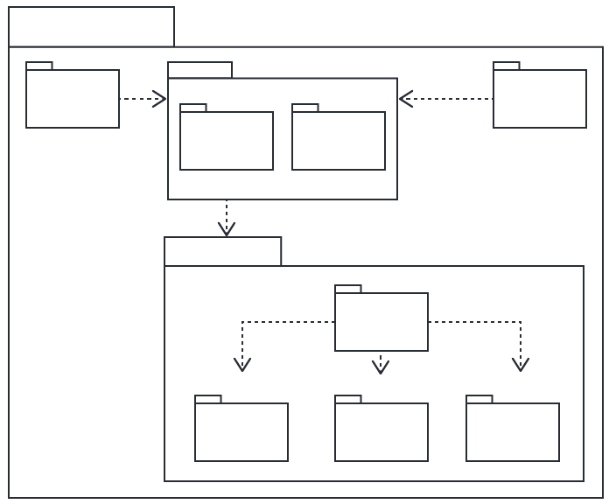

Slide 43
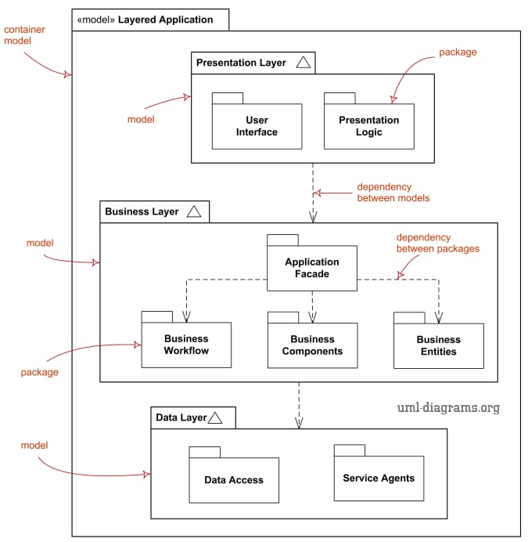

Slide 44
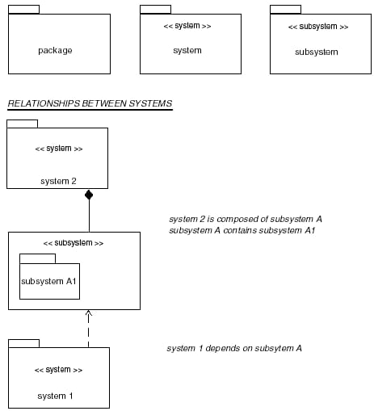

Slide 45
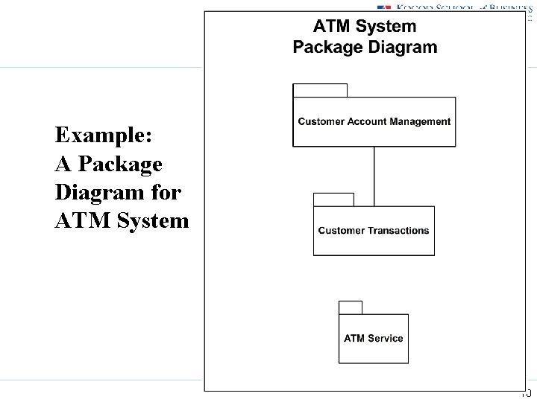

Slide 46
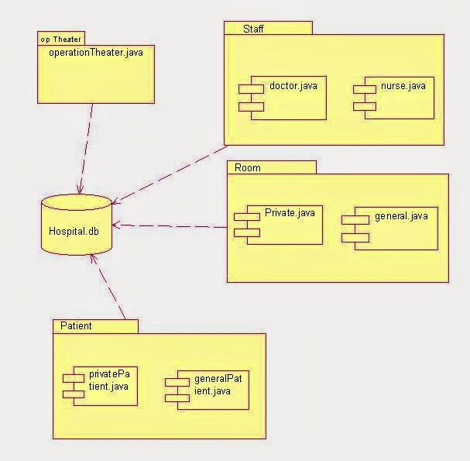
Package Diagram for Hospital Management System

Slide 47
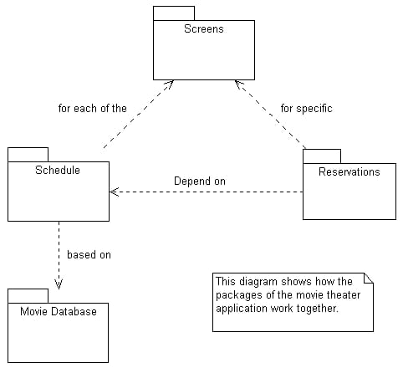
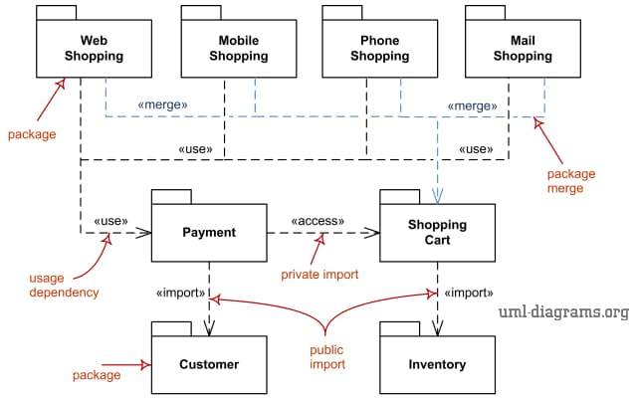
Package Diagram for shopping System

Slide 48
Package Diagram for Movie Theatre Application System

